Slide 1
Graph .NET SDK v5 preview

Slide 2
Highlights
Generated with new tool called Kiota
Enhancements to enrich user experiences across Microsoft Graph
Backing store
Support $count endpoints
Support for OData Cast endpoints
Parameter objects

Slide 3
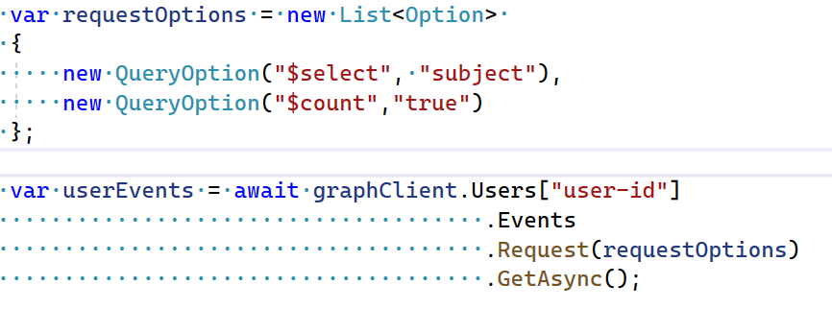
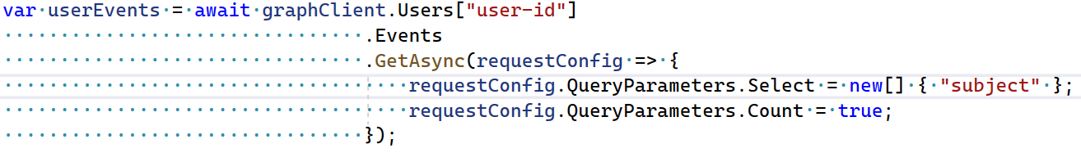
Developer Experience
V4
V5

Slide 4
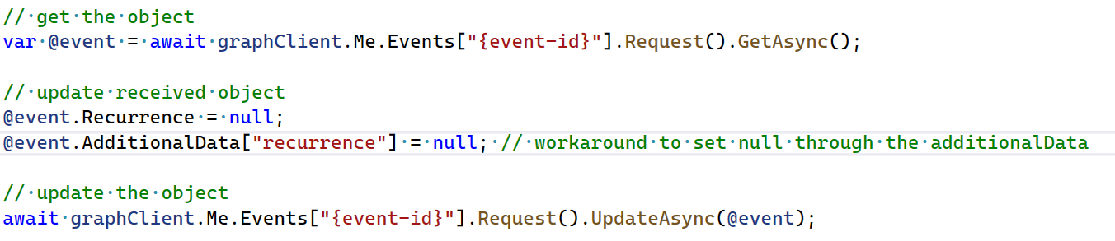
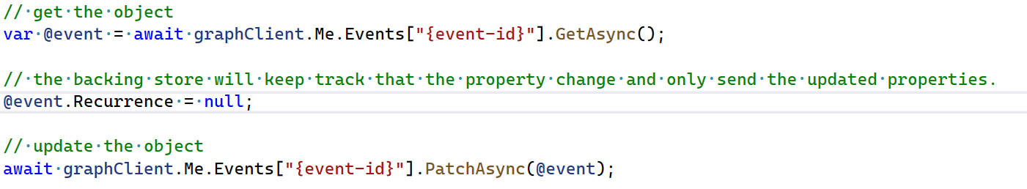
Backing Store
V4
V5

Slide 5
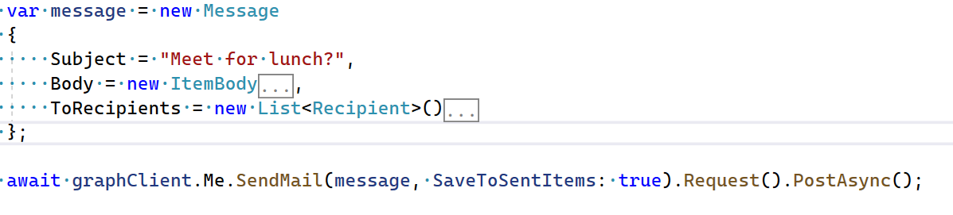
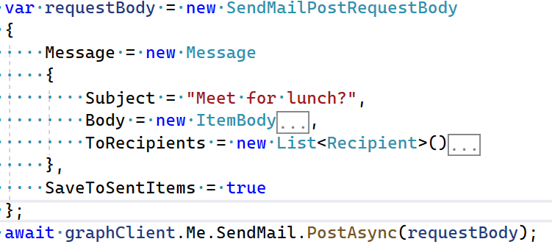
Parameter objects
V4
V5

Slide 6
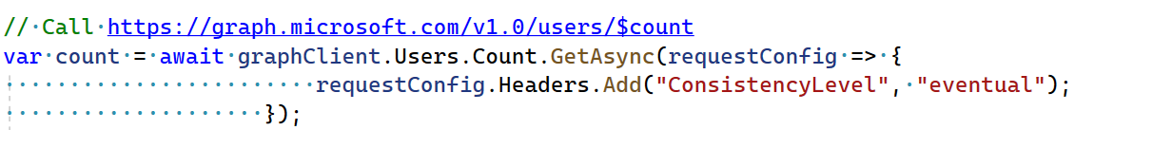
Support for $count segments
Support for OData Cast segments

Slide 7
Conclusion
aka.ms/graph/sdk/dotnet-preview

